Slide 1

Task 1 - Assessment Brief Security and Forensic Tools
Presented By:

Slide 2
Nessus Overview
Purpose:
Nessus is an effective vulnerability scanning tool that can be used to find and evaluate vulnerabilities in a system or network.
By offering insights into potential vulnerabilities in security, it supports proactive risk management.
Nessus is widely used in cybersecurity for:
Vulnerability assessment.
Penetration testing.
Compliance checking.
Patch management.
Notes:
Nessus is a vulnerability scanning tool developed by tenable company based in Columbia, Maryland USA
It is very reputable tool in Cybersecurity industry and is used for assessing vulnerabilities in a network of system
It also helps in risk management and provides insights into potential security weaknesses
Nessus is widely used for Vulnerability assessment and penetration testing teams
Also it is used by Governance, Risk and Compliance experts for compliance management
For fixing the vulnerabilities we can also perform patch management with this tool

Slide 3

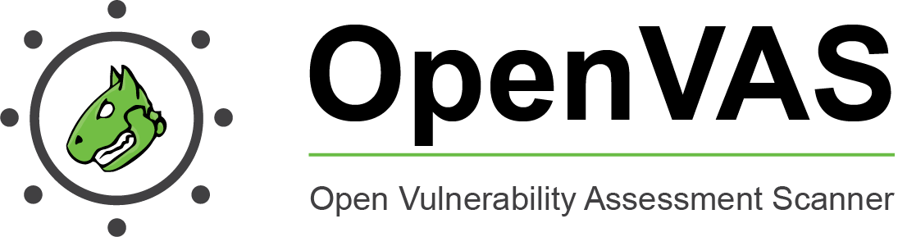

Alternatives and Comparison
Feature
Scanning Scope | Network devices, servers, endpoints | Network devices, servers, endpoints, cloud assets | Network devices, servers, endpoints | Network devices, servers, endpoints
Vulnerability Coverage | Extensive, industry-leading plugin library | Extensive, with threat intelligence integration | Large plugin library | Large plugin library
False Positives | Moderate | Low | High | Moderate
Reporting | Basic recommendations | Detailed remediation steps and workflow automation | Limited guidance | Recommendations and patch management integration
Remediation | Basic recommendations | Detailed remediation steps and workflow automation | Limited guidance | Recommendations and patch management integration
Scalability | Supports various compliance frameworks | Highly scalable and cloud-native | Handles smaller networks well | Highly scalable
Notes:
In this table we have compared Nessus with other tools which can also be considered its alternatives
We have compared these tool based on different features like Scanning scope, vulnerability coverage, false positives, reporting, remediation and scalability
False Positives: This happens when a condition or characteristic is falsely indicated to be present by a test, model, or other decision-making process.

Slide 4
Strengths
Extensive Vulnerability Coverage
Detailed Reporting
Compliance Support
Ease of Use
Scalability
Notes:
Extensive Vulnerability Coverage: Industry-leading plugin library with wide range of supported systems and applications.
Detailed Reporting: Generates prioritized reports with vulnerability details, risk scoring, and remediation recommendations.
Compliance Support: Aligns with various frameworks like PCI-DSS, HIPAA, and ISO 27001, simplifying audits.
Ease of Use: Web-based interface with user-friendly features and intuitive navigation.
Scalability: Supports large networks with efficient scanning and reporting even for complex environments.

Slide 5
Weaknesses
False Positives
Limited Remediation
Cost
Complexity.
Resource Intensive
Notes:
False Positives: While generally accurate, Nessus can generate false positives requiring manual verification.
Cost: Paid software with different tiers, potentially expensive for small businesses.
Limited Remediation: Basic recommendations, lacks advanced features like patch management or automated workflows.
Complexity: Advanced features may require technical expertise, especially for configuration and customization.
Resource Intensive: Extensive scans can consume system resources, impacting performance on underpowered machines.

Slide 6
Limitations
Focus on Vulnerabilities
Internal Network Visibility
Limited Web Application Scanning
False Negatives
Customization Challenges
Notes:
Focus on Vulnerabilities: Primarily identifies known vulnerabilities, may not detect zero-day attacks or novel threats.
Internal Network Visibility: Requires proper network access to scan internal systems, external scans may miss vulnerabilities.
Limited Web Application Scanning: Capabilities for web application security testing are not as advanced as dedicated tools.
False Negatives: Certain vulnerabilities, especially less common ones, may be missed due to plugin limitations.
Customization Challenges: While customizable, advanced configuration requires deeper understanding of its features.
Definition:
False Negative: It happens when a condition or feature that is actually present is mistakenly indicated as absent by a test, model, or other decision-making process.

Slide 7
Why would I use NESSUS?
Nessus is a very useful tool for cybersecurity professionals
It offers a pro-active method of finding weaknesses.
The overall security posture is strengthened through integration with other tools.
Systematic vulnerability assessments are made easier by Nessus
Frequent scans support continuous monitoring.
In the field of security, comprehensive reports facilitate well-informed decision-making.

Slide 8
Why would I use NESSUS?
Improved reporting functionalities.
Enhanced support for web application security testing.
Integration with more third-party tools for security assessments.

Slide 9
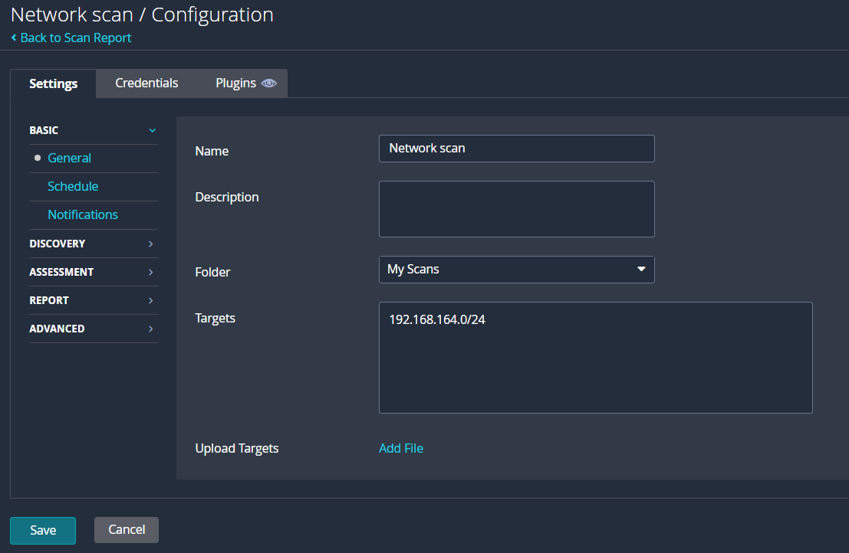
Creating new scan
Notes:
I have scanned my own network using Nessus
First of all I chose the option of network scan from scan options and created a new scan
And I set the target value equal to 192.168.164.0/24

Slide 10
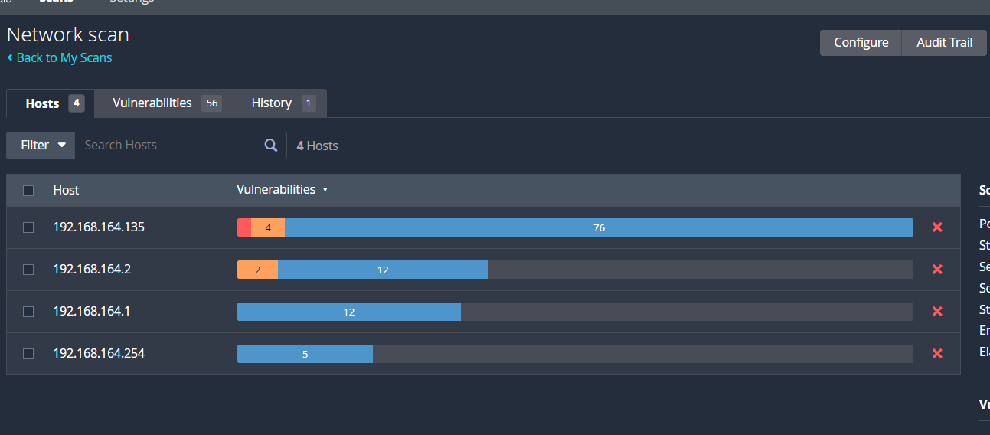
Scan results
Notes:
After successful completion of can we can ee that 4 host different host were in the network and their IPs are:
192.168.164.135
192.168.164.2
192.168.164.1
192.168.164.254
We can see that in total 56 vulnerabilities were discovered

Slide 11
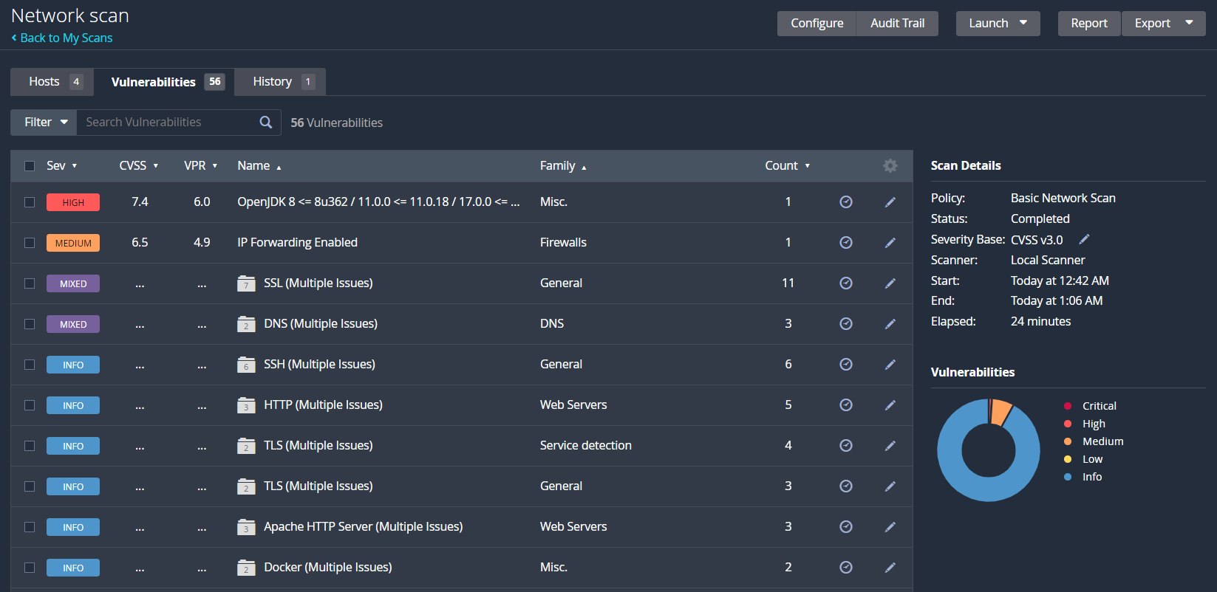
Scan Results
Notes:
Here we can see the list of all the vulnerabilities found in the network
Most severe vulnerability is OpenJDK 8 vulnerability and its CVSS score is 7.4
The second most critical vulnerability is IP Forwarding Enabled vulnerability whose CVSS score is 6.5

Slide 12
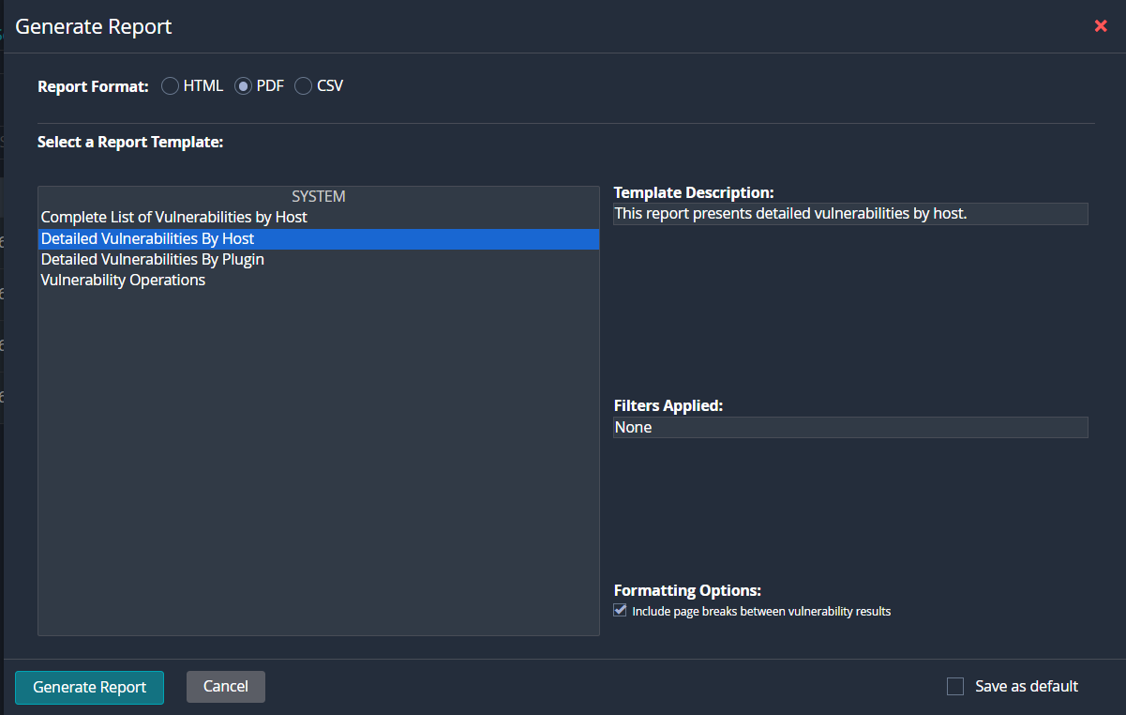
Generating Report
Notes:
We can export the scan results in the form of comprehensive report

Slide 13
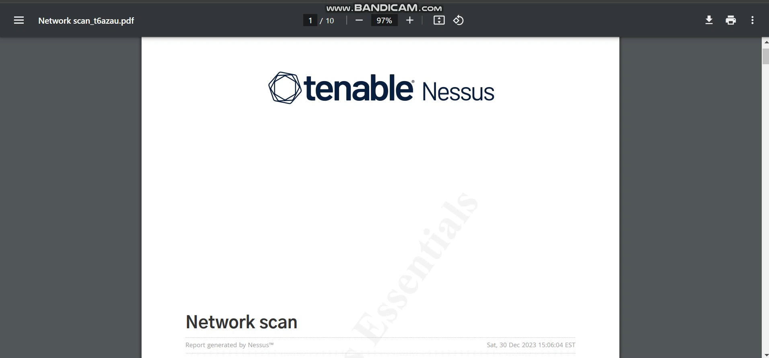
Extracted PDF report
Notes:
Here we have the detailed PDF report that was exported from the Nessus tool for the Network scan
Play the video and show detailed results for all the four hosts.

Slide 14
THANK YOU!

